Slide 1

Group 14®
project 7
Power generation data
DAT 540 - Autumn 2022 - Nov. 18, 2022

Slide 2
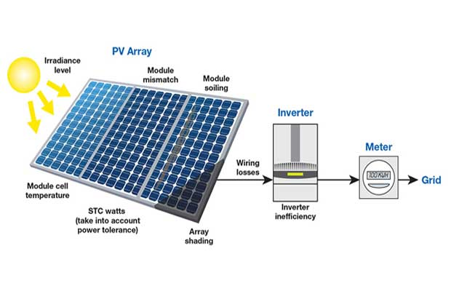
Introduction
Two solar power plants (India)
Power generation data (2) & Weather sensor data (2)
Sourced: Kaggle

Slide 3
Data Cleaning & Identification
No null values, no duplicates
Data types verified, anomalies removed
 |  | Date-time | Integer | String | Float | Float | Float | Float
Plant 1 | Power gen. data (68778,7) | DATE_TIME | PLANT_ID | SOURCE_KEY | DC_POWER | AC_POWER | DAILY_YIELD | TOTAL_YIELD
 | Weather data (3182, 6) | DATE_TIME | PLANT_ID | SOURCE_KEY | AMBIENT_TEMPERATURE | MODULE_TEMPERATURE | IRRADIATION
Plant 2 | Power gen. data (67698, 7) | DATE_TIME | PLANT_ID | SOURCE_KEY | DC_POWER | AC_POWER | DAILY_YIELD | TOTAL_YIELD
 | Weather data (3259, 6) | DATE_TIME | PLANT_ID | SOURCE_KEY | AMBIENT_TEMPERATURE | MODULE_TEMPERATURE | IRRADIATION

Slide 4
Analysis & Feature Selection
Plant 1 power generation – float features
 | DC_POWER | AC_POWER | DAILY_YIELD | TOTAL_YIELD
count | 68778.0 | 68778.0 | 68778.0 | 6.877e+04
mean | 3147.4 | 307.8 | 3295.9 | 6.978e+06
std | 4036.4 | 394.3 | 3145.1 | 4.16e+05
min | 0.0 | 0.0 | 0.0 | 6.18e+06
25% | 0.0 | 0.0 | 0.0 | 6.51e+06
50% | 429.0 | 41.4 | 2658.7 | 7.146685e+06
75% | 6366.9 | 623.6 | 6274.0 | 7.268706e+06
max | 14471.1 | 1410.9 | 9163.0 | 7.846821e+06

Slide 5
Analysis & Feature Selection
Plant 1 power generation – float features
 | DC_POWER | AC_POWER | DAILY_YIELD | TOTAL_YIELD
count | 68778.0 | 68778.0 | 68778.0 | 6.877e+04
mean | 3147.4 | 307.8 | 3295.9 | 6.978e+06
std | 4036.4 | 394.3 | 3145.1 | 4.16e+05
min | 0.0 | 0.0 | 0.0 | 6.18e+06
25% | 0.0 | 0.0 | 0.0 | 6.51e+06
50% | 429.0 | 41.4 | 2658.7 | 7.146685e+06
75% | 6366.9 | 623.6 | 6274.0 | 7.268706e+06
max | 14471.1 | 1410.9 | 9163.0 | 7.846821e+06

Slide 6
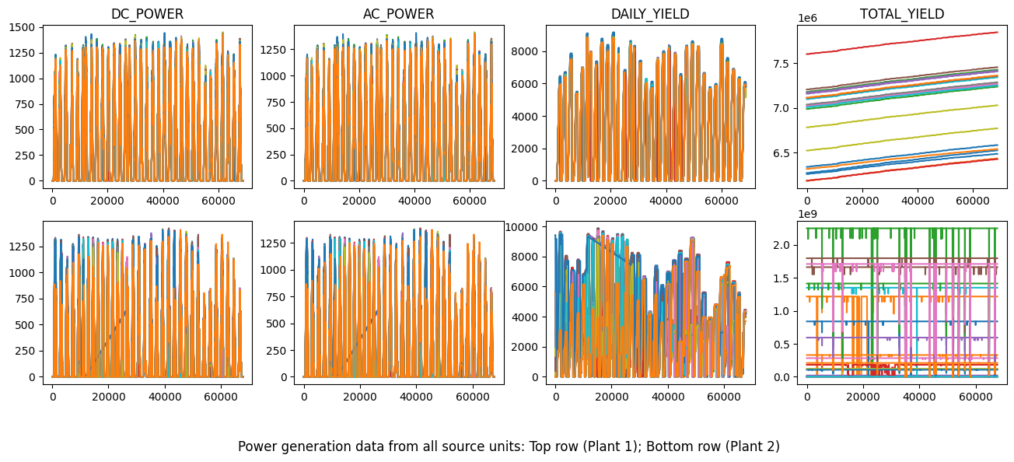
Analysis & Feature Selection
Vizualization of Power data (Plant 1 & Plant2)
High variability in data
Irregularities in Plant 2 data

Slide 7
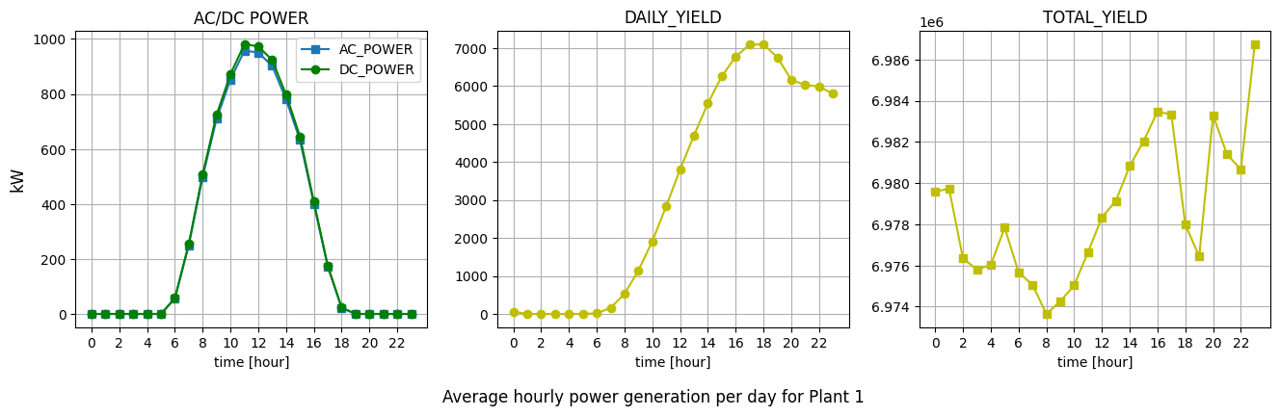
Analysis & Feature Selection
Averages over date-times
High variability in data
Missing records for some sources

Slide 8
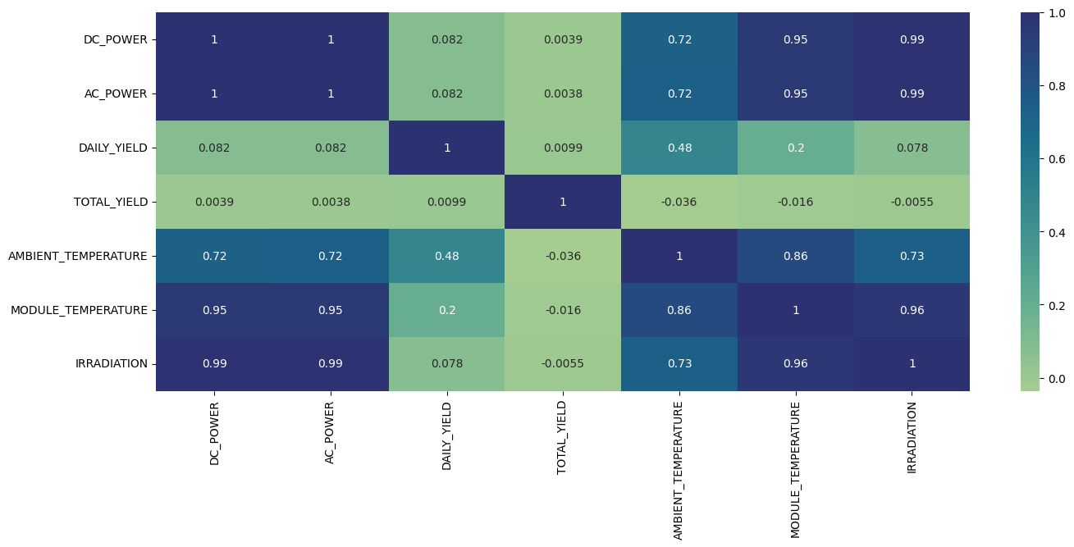
Analysis & Feature Selection
Correlation map

Slide 9
Analysis & Feature Selection
Decisions:
Merge power and sensor data
Treat both plants seperately
Selected features:
Ambient temperature
Module temperature
Irradiation
DC Power (target)

Slide 10
Problem Statement
Predict the DC POWER generated for any weather condition
Ambient temperature
Module temperature
Irradiation

Slide 11
ML Model Selection
Regression model
Continuous data
Robust regression model (Random forest, KNN etc)
High variablitiy of data
Scaling – Sklearn MinMaxScaler
Target and input features have widely varying ranges

Slide 12

Parameter tuning
Degree of polynomials
Train-test split ratio

Slide 13
Model Evaluation
Sklearn cross validation module
Reveals better performance of polynomial regression over linear regression
Plant 1 : Cross-validation with 10 folds
Model | R2 | nMSE
Linear Regression | 0.98 | -3457.70
Random Forest | 0.98 | -3308.50
Polynomial Regression | 0.98 | -3007.92
Ridge Regression | 0.98 | -3458.09

